Slide 1






The Ecological Structure of Mosquito Population Dynamics: Insights from India, Consequences for Malaria Control
Charlie Whittaker, Peter Winskill, Marianne Sinka, Samuel Pironon, Claire Massey, Peter Gething, Daniel Weiss, Ashwani Kumar, Azra Ghani & Samir Bhatt

Slide 2
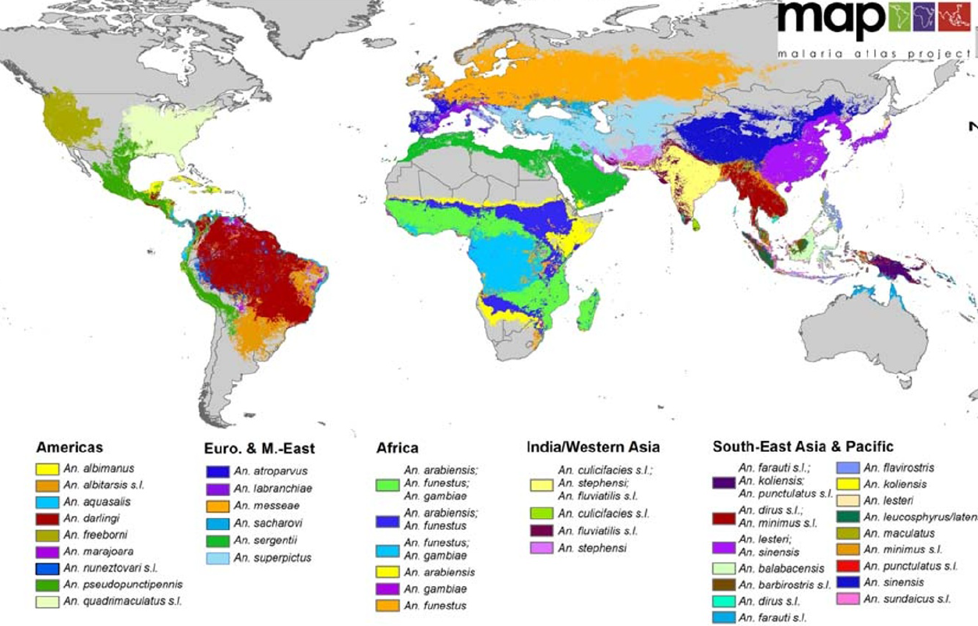
Anopheline mosquitoes are responsible for malaria transmission worldwide
Malaria is transmitted by mosquitoes of the Anopheles genus
70 possess the capacity to transmit human malaria parasites
Heterogeneously distributed around the globe.
Yields marked differences in transmission dynamics across different contexts.
Sinka et al, Parasites & Vectors, 2012 https://parasitesandvectors.biomedcentral.com/articles/10.1186/1756-3305-5-69

Slide 3
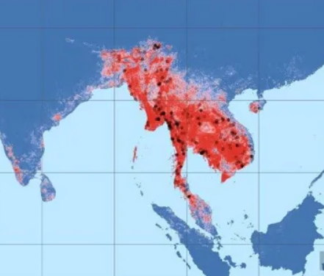
Previous work has focussed on mapping the spatial distribution of these vectors…
Work has on characterising the spatial distribution (presence/absence) of these vectors.
Less attention paid to the temporal patterns of abundance.
Mosquito populations are highly dynamic.
These dynamics define the temporal profile of malaria risk in a setting.
Understanding drivers of these dynamics is important.
Numerous interventions depend on accurate timing of delivery in relation to seasonal peaks.
Sinka et al, Parasites & Vectors, 2011 https://parasitesandvectors.biomedcentral.com/articles/10.1186/1756-3305-4-89

Slide 4
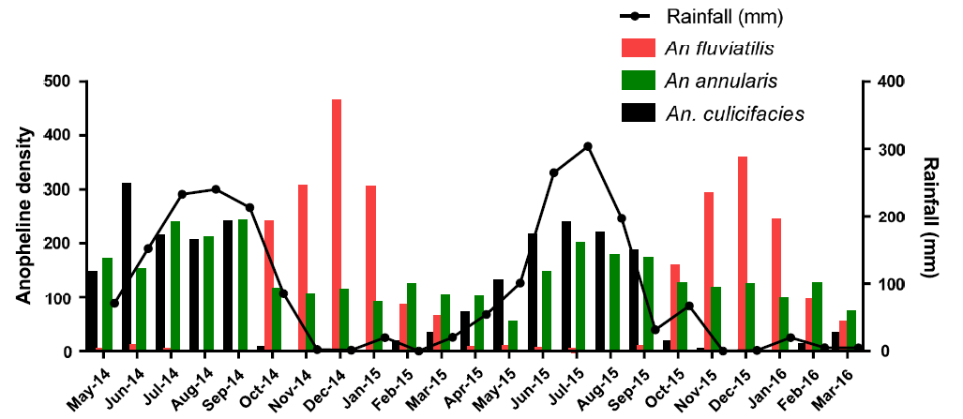
Many outstanding questions surrounding the drivers of these dynamics
Role of Rainfall?
Considered a key determinant, but exact influence depends heavily on the mosquito species.
Other Environmental Factors?
Temperature, vegetation, humidity and the dynamic profile of these and other ecological factors.
Das et al, 2017, https://malariajournal.biomedcentral.com/articles/10.1186/s12936-017-1833-9
Species Specific Breeding Preferences?
Substantial variation - rainfed pools, freshwater lakes, rivers, brackish etc.
How do ecological factors interact with species-specific traits e.g. (breeding preferences) to shape and structure population dynamics?
Notes:
Role of Rainfall?
Typically considered a key determinant.
Exact influence depends heavily on the mosquito species.
Anopheles funestus frequently displays dynamics not concordant with rainfall.

Slide 5
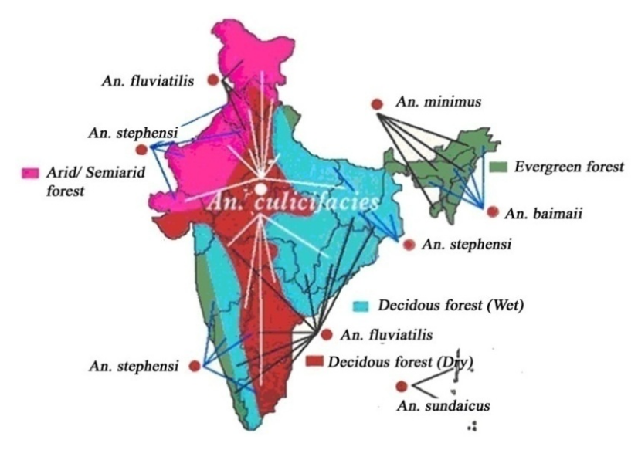
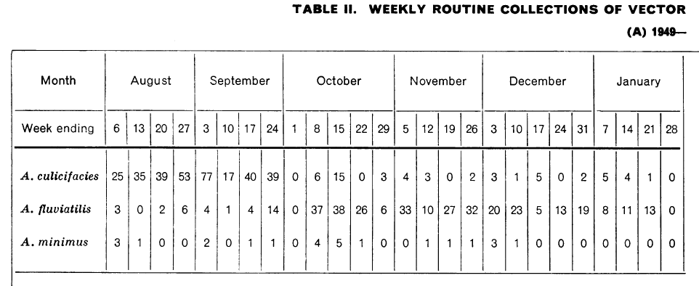
India as a case study for studying Anopheline dynamics
Along with nineteen countries in sub-Saharan Africa, accounts for 85% of the global malaria burden.
Including almost 50% of global Plasmodium vivax burden.
One of the countries identified as part of the WHO’s “High Burden, High Impact” strategy.
High diversity of Anopheline species able to transmit malaria.
And long history of high-quality entomological data collection.
Dev et al, 2013. https://www.intechopen.com/books/anopheles-mosquitoes-new-insights-into-malaria-vectors/the-dominant-mosquito-vectors-of-human-malaria-in-india
Issaris et al, Bulletin of the WHO, 1953 https://www.ncbi.nlm.nih.gov/pmc/articles/PMC2542115/

Slide 6
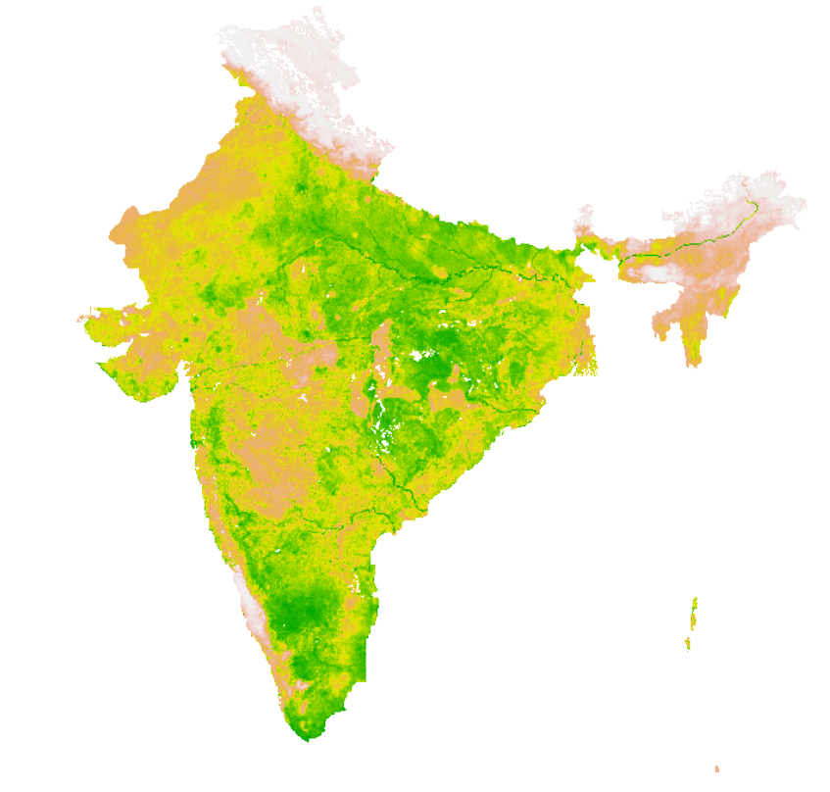
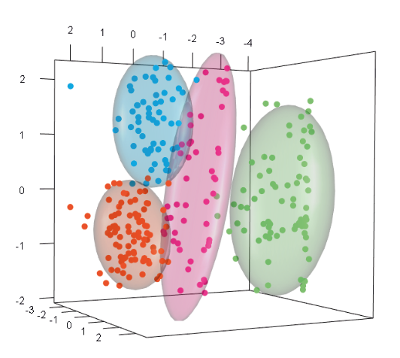
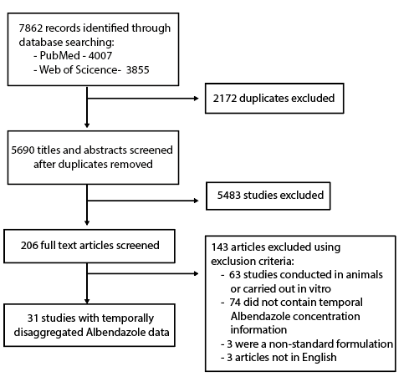
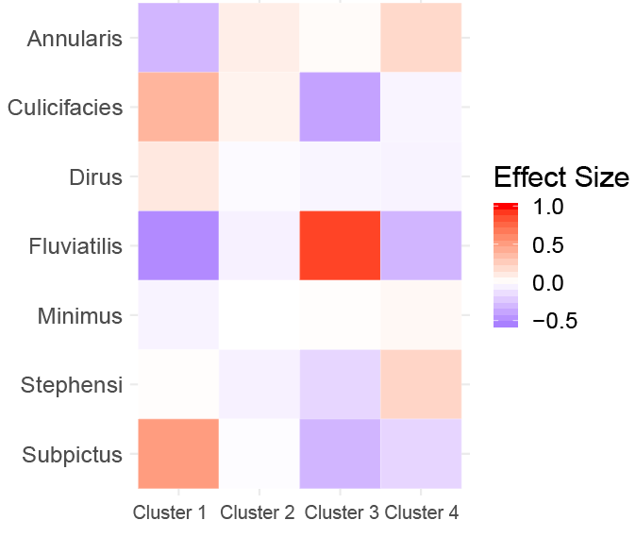
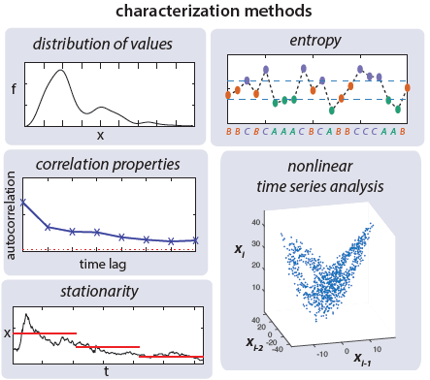
Overview of the Work
Systematic Review of Mosquito Time Series Catch Data
Spatial Prediction of Seasonal Profiles
Clustering of Similar Time Series
Characterisation of Temporal Properties
Exploring the Drivers of Different Temporal Patterns

Slide 7
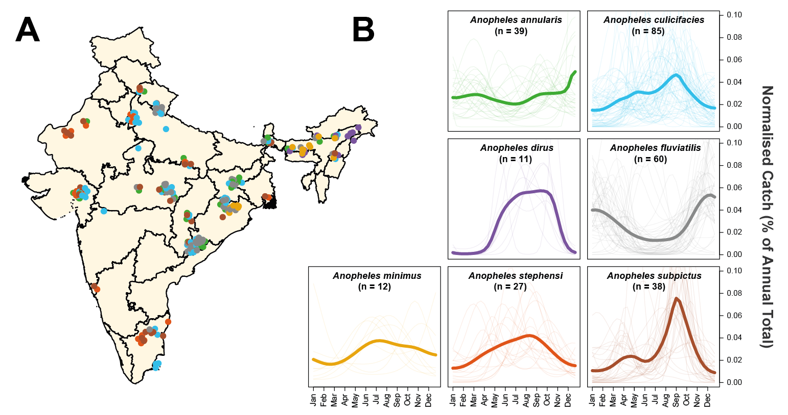
A systematic review revealed substantial diversity in mosquito population dynamics across India
272 time series at monthly resolution.
Spanning 7 dominant vector species and 117 locations across India.
Substantial diversity in population dynamics observed.
Both between species and within species.

Slide 8
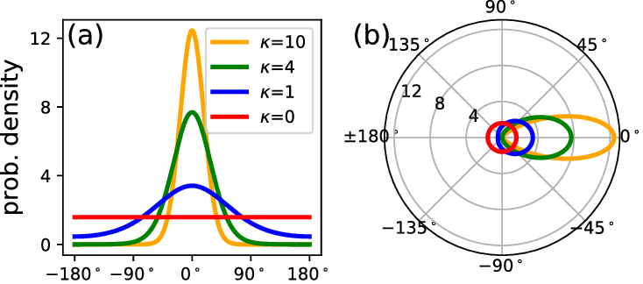
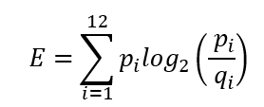
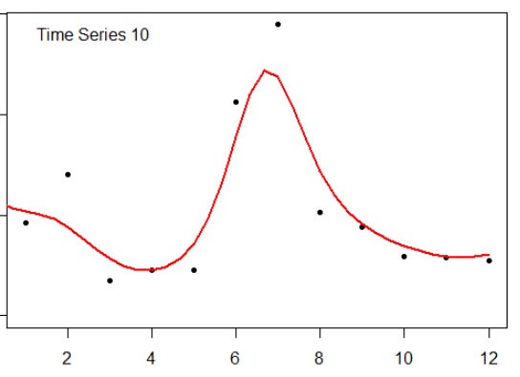
Feature based representation of the collated time series
Mathematical operations used to characterise the temporal properties of each time series.
Peak distance from January
Von Mises Distribution:
1 and 2 component fitting, MLE estimates of parameters.
Output: 7 numbers per time series, describing its temporal properties
KL Divergence:
Measuring deviation from a uniform distribution.
Periodic Kernel Median
From Negative Binomial Gaussian Process fitting
Proportion of Points > 1.65x Mean

Slide 9
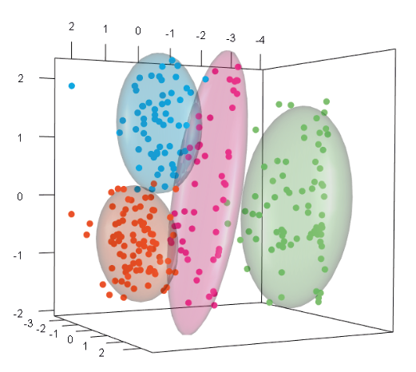
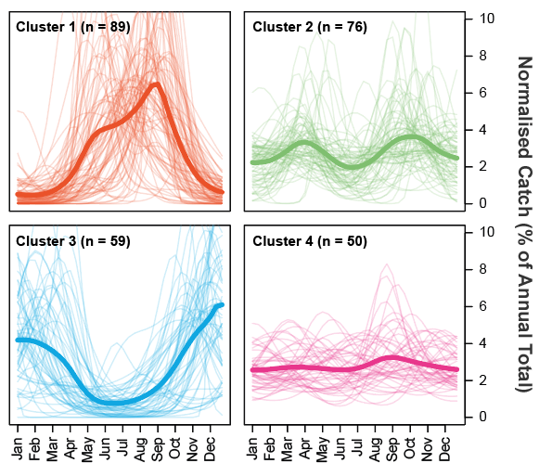
Clustering of time series according to temporal properties reveals distinct temporal profiles
Principal Components Analysis combined with k-Means clustering: 4 clusters of time series with similar temporal properties identified.
Differences in extent and timing of seasonal peaks.

Slide 10
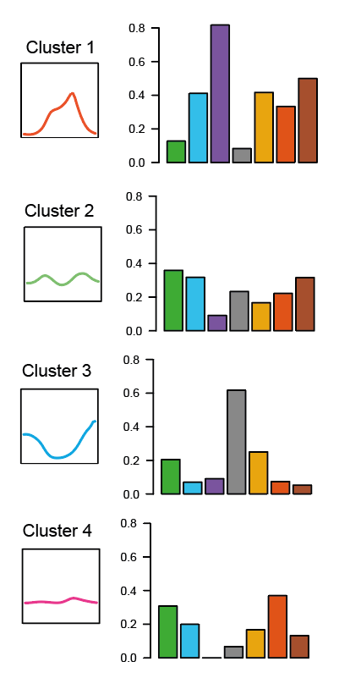
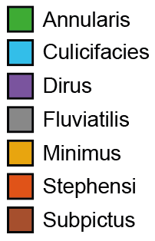
Analysis of species composition of temporal clusters reveals species-specific patterns
Some species exhibits consistent temporal patterns.
Anopheles fluviatilis & Cluster 3 (dry season peaking).
Others exhibit plastic, flexible dynamics, depending on the location.
E.g. Anopheles minimus (distributed evenly across all 4 Clusters).
Suggests role for both species-specific factors and the environment in shaping population dynamics.
Comparative importance variable between species.

Slide 11
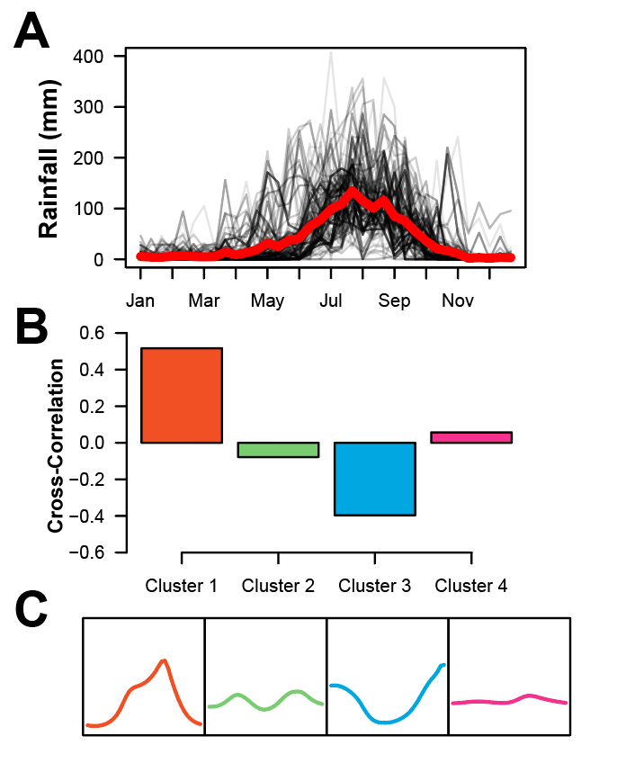
Rainfall patterns do not substantially differ across locations
Suggests that the influence of rainfall on population dynamics can be highly variable.
Leading to population spikes that are concordant, discordant or invariant of rainfall, depending on the context.
Can be related to mosquito breeding habits.
Some prefer transient, rainfed pools of water → positively associated with rainfall.
Others prefer river-edges but can be washed away during periods of heavy rain → negatively correlated with rainfall.
Notes:
Extracted year-specific rainfall data for every sampled location.
Calculated cross-correlation between rainfall and mosquito catch for each cluster.

Slide 12
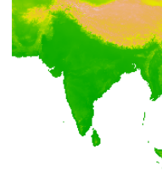
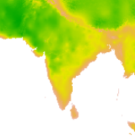
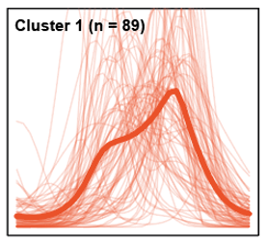

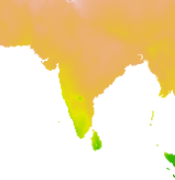
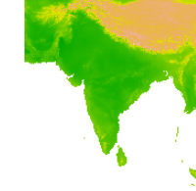
Multinomial logistic regression to explore associations
Use an array of environmental covariates (Rainfall, Temperature, EVI etc) along with species to predict which temporal pattern cluster a time series belongs to.
=
+
Output: Probability of belonging to each temporal pattern cluster.
4 coefficients for each predictor, 1 for each temporal pattern cluster. Each coefficient measures the strength of the association between the predictor and the temporal pattern cluster.

Slide 13
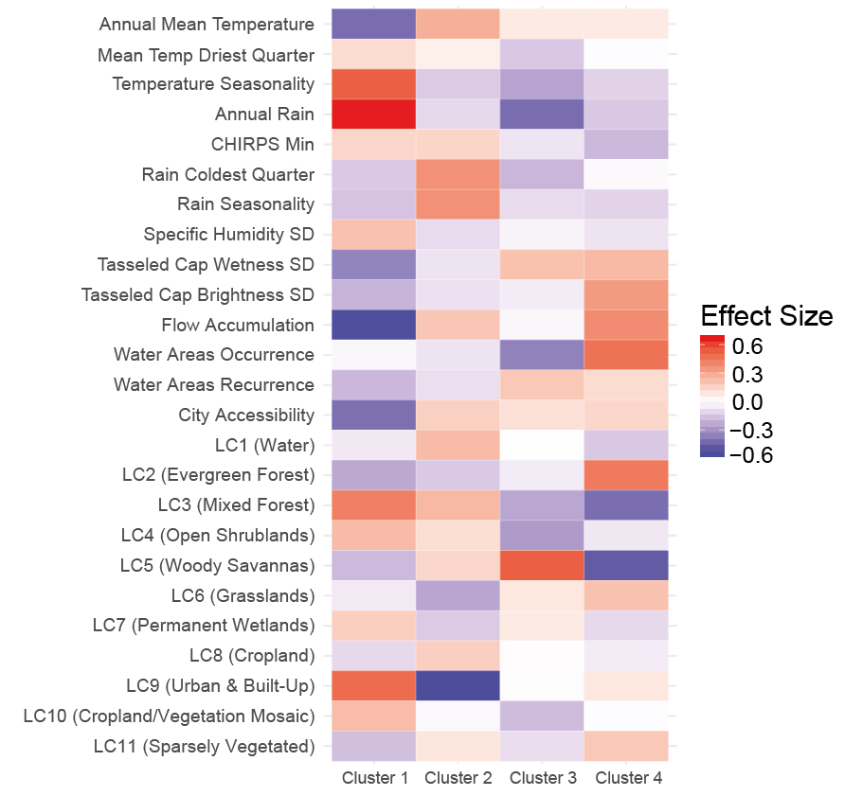
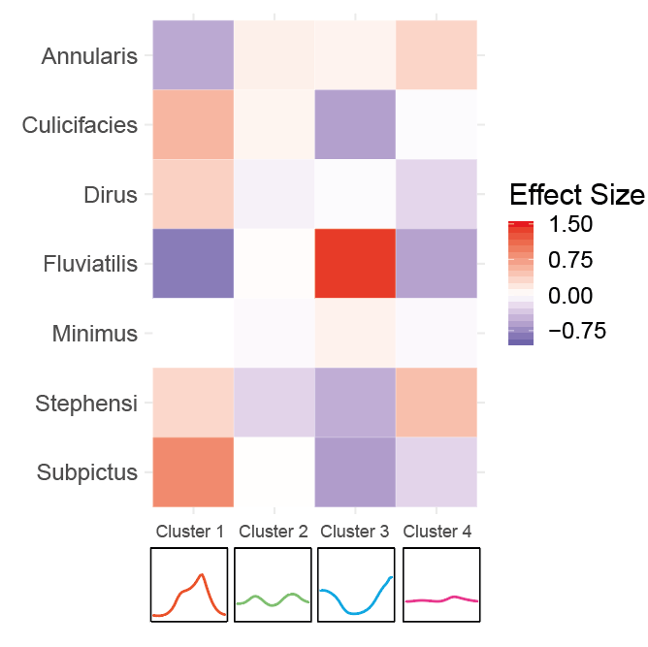
Distinct, environmental and species-specific associations

Slide 14
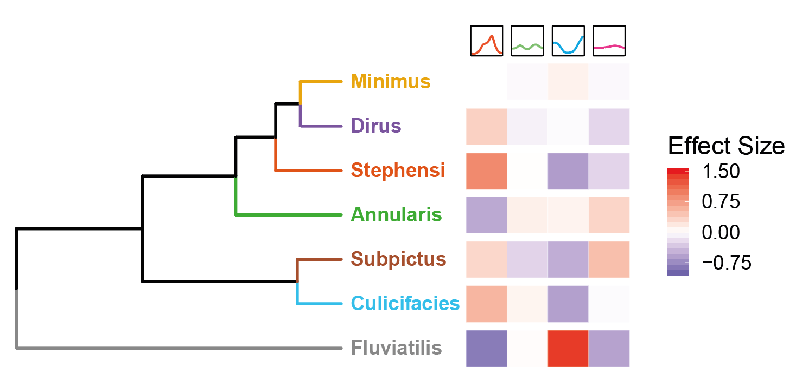
Hierarchical clustering reveals species-specific associations with temporal patterns
Anopheles fluviatilis only mosquito associated with dry-season dynamics.
Similar patterns of association for Anopheles culicifacies and Anopheles subpictus.
Minimal species-specific effect for Anopheles minimus, dirus and stephensi.
Suggests role for environmental factors.

Slide 15
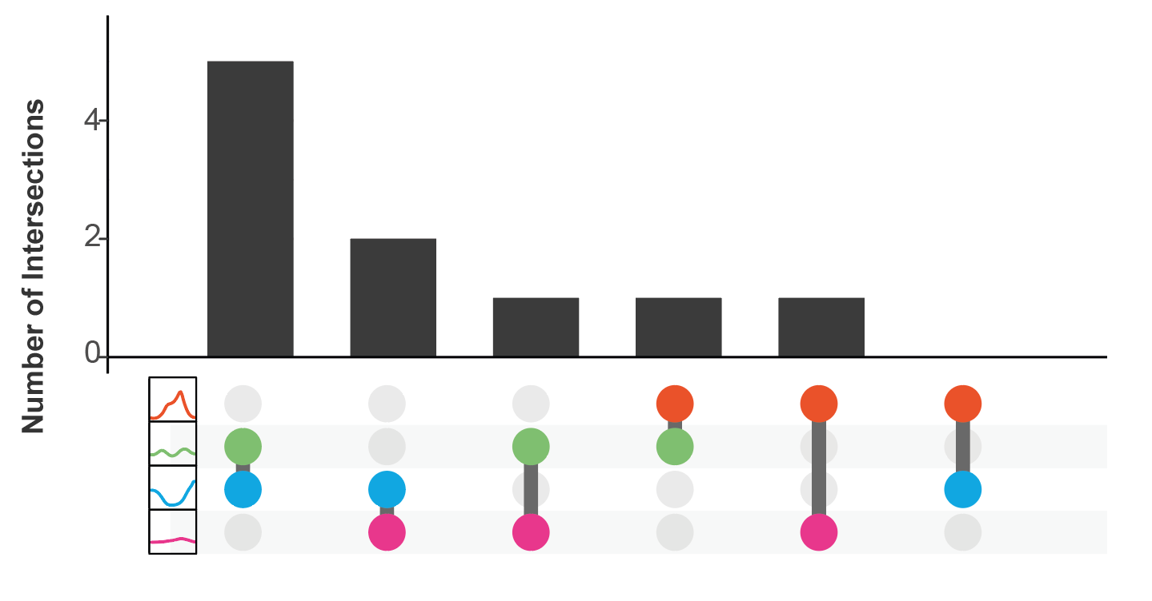
Distinct ecological factors contribute to the different temporal patterns observed
Ranked coefficients extended to include top 15 for each cluster.
Overlap in coefficients between clusters assessed.
Minimal overlap between clusters.
Suggests distinct ecological processes determine different temporal dynamics.

Slide 16
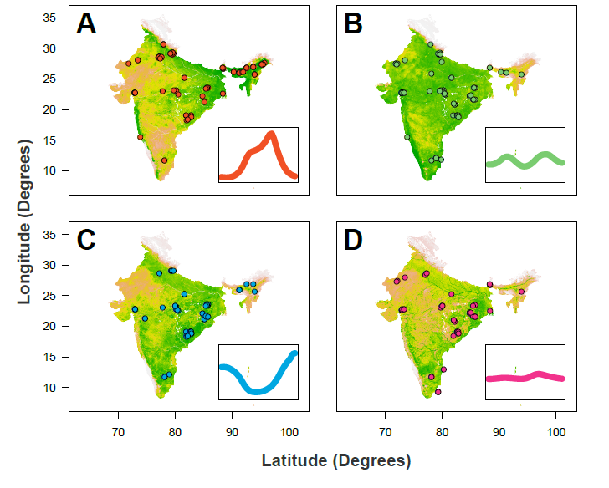
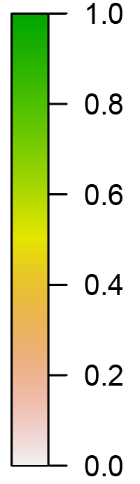
Integrating these results with vector spatial distributions allows prediction of seasonality
Regression results integrated with maps of vector occurrence probability.
Probability of a location containing ≥1 mosquito with a given temporal profile calculated.
Distinct but overlapping geographical distributions of temporal dynamics observed.

Slide 17
Mosquito population dynamics are shaped by a complex interplay of species-specific and environmental factors
Species-specific factors AND the environmental context shape population dynamics. Comparative importance depends on the context:
Anopheles fluviatilis: dynamics relatively invariant to environmental conditions.
Anopheles culicifacies: plastic dynamics, different in ecological contexts.
Understanding these patterns is important for:
Timing of delivery of seasonal interventions.
Predicting the (unintended) impacts of environmental change on mosquito dynamics.
However, mosquitoes are just one piece of the puzzle ➔ extending these results to link them with epidemiological outcomes (i.e. malaria incidence) is neccessary.

Slide 18
Acknowledgements
Michelle Nguyen
Pete Gething
Daniel Weiss
Samir Bhatt
Azra Ghani
Pete Winskill
Marianne Sinka
Ashwani Kumar
Claire Massey
Samuel Pironon

Slide 19
One more (hopefully exciting) thing…

Slide 20
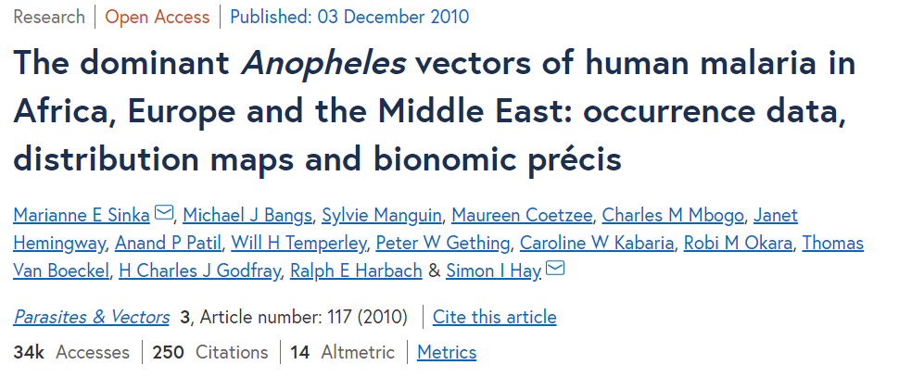

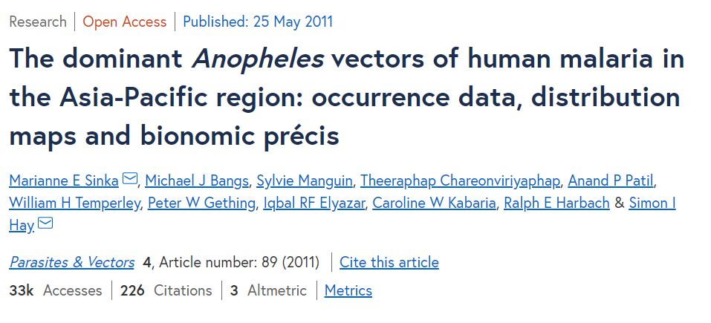
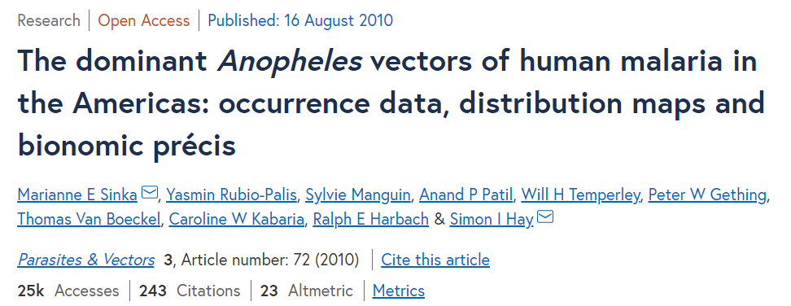
Why do I mention this???
Invaluable entomological resource for the malaria community.
Cumulatively cited >1450 times.
Would like to do something similar with seasonal dynamics!

Slide 21
Collaboration is nice
WE SHOULD COLLABORATE!!!!
We rarely hang out (in an academic sense) as a group
You’re all awesome researchers who I respect and admire greatly

Slide 22
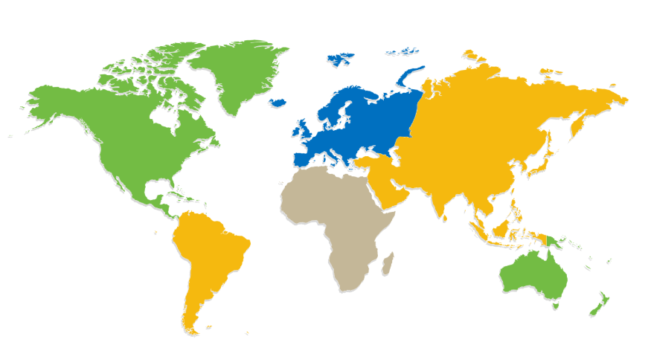
Systematic Review ➔ Analyses ➔ Publication
Taking Seasonality Worldwide…
Collaboration is nice.
We should collaborate.
?
?
?
?
?
Note: India already complete. Gina and I are covering some parts of West and East Africa for some SMC-related work. The rest of Africa, South America and Asia in particular all remain outstanding….

Slide 23
What I can promise?
Fair attribution of authorship!
Friendship that transcends mosquitoes!!
The opportunity to learn some of the techniques I’ve been fortunate enough to learn through doing this work (and vice versa re your input and expertise!)
Although, to emphasise, no skills other than enthusiasm are required to be a part of this!!!
The opportunity to actively contribute to the analyses (not just the review process), if you want to!!!!
Probably, actually, quite a lot of fun!!!!!
The warm, glowing feeling from working together as a one big malaria group on a project!!!!!!
For this not to be a huge drain on your time – i.e. a relatively low time intensive way of getting your name on a paper!!!!!!!
Let me know – either in person or charles.whittaker16@imperial.ac.uk

Slide 24


Slide 25
Anopheline mosquitoes are responsible for malaria transmission worldwide
Malaria is transmitted by mosquitoes of the Anopheles genus
70 possess the capacity to transmit human malaria parasites
Heterogeneously distributed around the globe.
Yields marked differences in transmission dynamics across different contexts.
Sinka et al, Parasites & Vectors, 2012 https://parasitesandvectors.biomedcentral.com/articles/10.1186/1756-3305-5-69

Slide 26
Previous work has focussed on mapping the spatial distribution of these vectors…
Work has on characterising the spatial distribution (presence/absence) of these vectors.
Less attention paid to the temporal patterns of abundance.
Mosquito populations are highly dynamic.
These dynamics define the temporal profile of malaria risk in a setting.
Understanding drivers of these dynamics is important.
Numerous interventions depend on accurate timing of delivery in relation to seasonal peaks.
Sinka et al, Parasites & Vectors, 2011 https://parasitesandvectors.biomedcentral.com/articles/10.1186/1756-3305-4-89

Slide 27
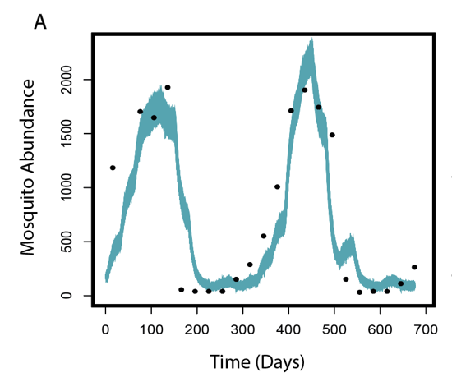
Many outstanding questions surrounding the drivers of these dynamics
Role of Rainfall?
Considered a key determinant, but exact influence depends heavily on the mosquito species.
Other Environmental Factors?
Temperature, vegetation and urbanicity all indicated as important.
Species Specific Breeding Preferences?
Substantial variation - rainfed pools, freshwaster lakes, rivers, brackish etc.
How do these ecological factors interact with species-specific breeding preferences to shape and structure population dynamics?
Notes:
Role of Rainfall?
Typically considered a key determinant.
Exact influence depends heavily on the mosquito species.
Anopheles funestus frequently displays dynamics not concordant with rainfall.

Slide 28
India is well suited to address these questions…
Diversity of Anopheline species able to transmit malaria.
Heterogeneous transmission environments.
Perennial, seasonal, vivax, falciparum etc.
Long history of high-quality entomological data collection.
Dev et al, 2013. https://www.intechopen.com/books/anopheles-mosquitoes-new-insights-into-malaria-vectors/the-dominant-mosquito-vectors-of-human-malaria-in-india
Issaris et al, Bulletin of the WHO, 1953 https://www.ncbi.nlm.nih.gov/pmc/articles/PMC2542115/

Slide 29
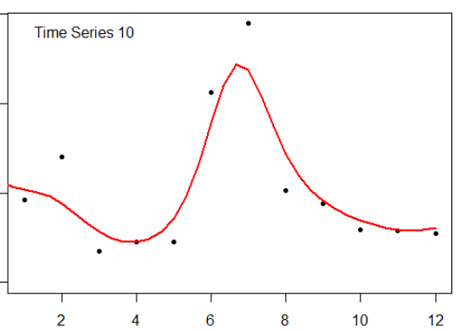
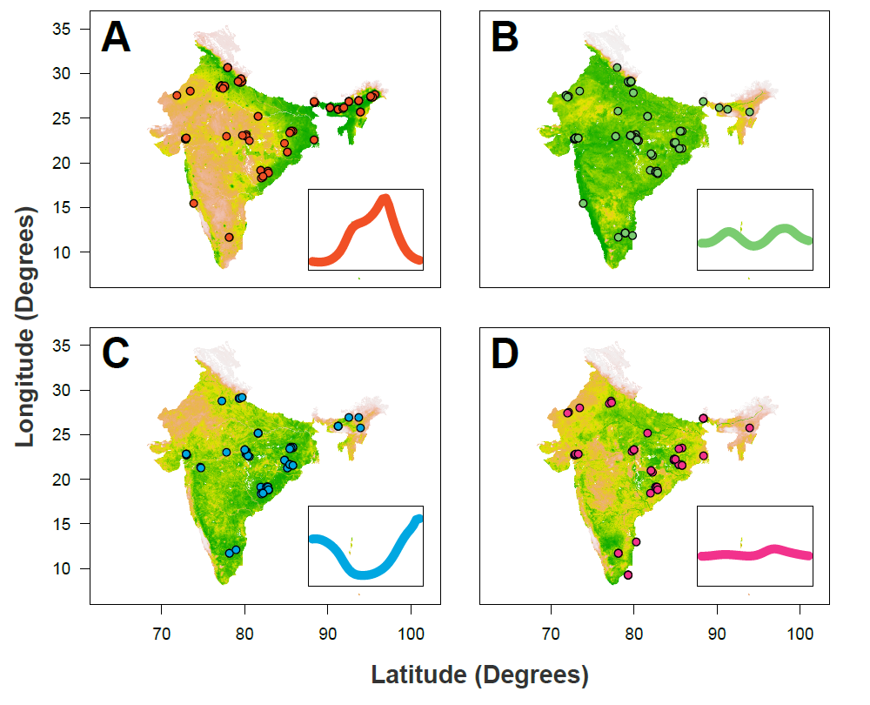
1) Systematic Review
2) Negative Binomial Gaussian Process Fitting
3) Characterisation of Temporal Properties
4) Multinomial Logistic Regression
5) Prediction of Mosquito Seasonality Across India

Slide 30
1) Systematic Review
2) Negative Binomial Gaussian Process Fitting
3) Characterisation of Temporal Properties
4) Multinomial Logistic Regression
5) Prediction of Mosquito Seasonality Across India

Slide 31
1) Systematic Review
2) Negative Binomial Gaussian Process Fitting
3) Characterisation of Temporal Properties
4) Multinomial Logistic Regression
5) Prediction of Mosquito Seasonality Across India

Slide 32
1) Systematic Review
2) Negative Binomial Gaussian Process Fitting
3) Characterisation of Temporal Properties
4) Multinomial Logistic Regression
5) Prediction of Mosquito Seasonality Across India

Slide 33
1) Systematic Review
2) Negative Binomial Gaussian Process Fitting
3) Characterisation of Temporal Properties
4) Multinomial Logistic Regression
5) Prediction of Mosquito Seasonality Across India

Slide 34
Feature based representation of the collated time series
Mathematical operations used to characterise the temporal properties of each time series.
Von Mises Distribution:
1 and 2 component fitting, MLE estimates of parameters.
KL Divergence:
Measuring deviation from a uniform distribution.
Periodic Kernal Median
From Negative Binomial Gaussian Process fitting
Additionally: Peak distance from January
Proportion of Points > 1.5x Mean
TOTAL: 7 OPERATIONS CHARACTERISING TEMPORAL PROPERTIES

Slide 35
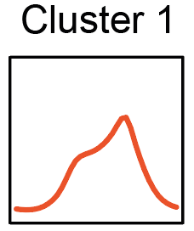
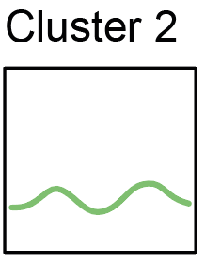
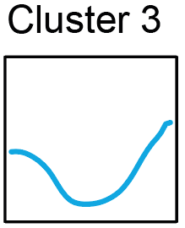
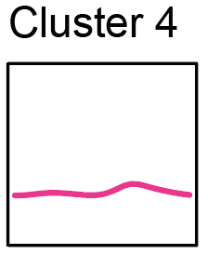
Ranking of ecological coefficients by cluster suggests distinct ecological niches (top 5 presented)…
Isothermality
Night Land Surface Temperature SD
Rain Driest Quarter
Flow Accumulation
Distance to Water Bodies
Population Density
Enhanced Vegetation Index
Rain Coldest Quarter
Max Temp Warmest Month
Landcover: Grasslands
Water Bodies Max Extent
Rain Warmest Quarter
Water Areas Occurrence
Landcover: Woody Savannahs
Enhanced Vegetation Index
Tasselled Cap Brightness
Rain Driest Quarter
Landcover: Woody Savannahs
Isothermality
Water Bodies Max Extent
Notes:
Cluster 1: doesn’t like isothermality, doesn’t like places where flow accumulation is high
Cluster 2: ???
Cluster 3: water bodies max extent: static, dry season available bodies. Landcover known to be suitable for fluviatilis…
Cluster 4: rain driest quarter – measure of how low rain availability goes. Likes isothermality

